Slide 1

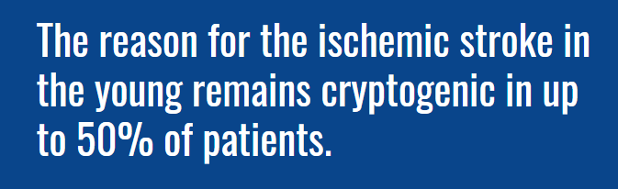
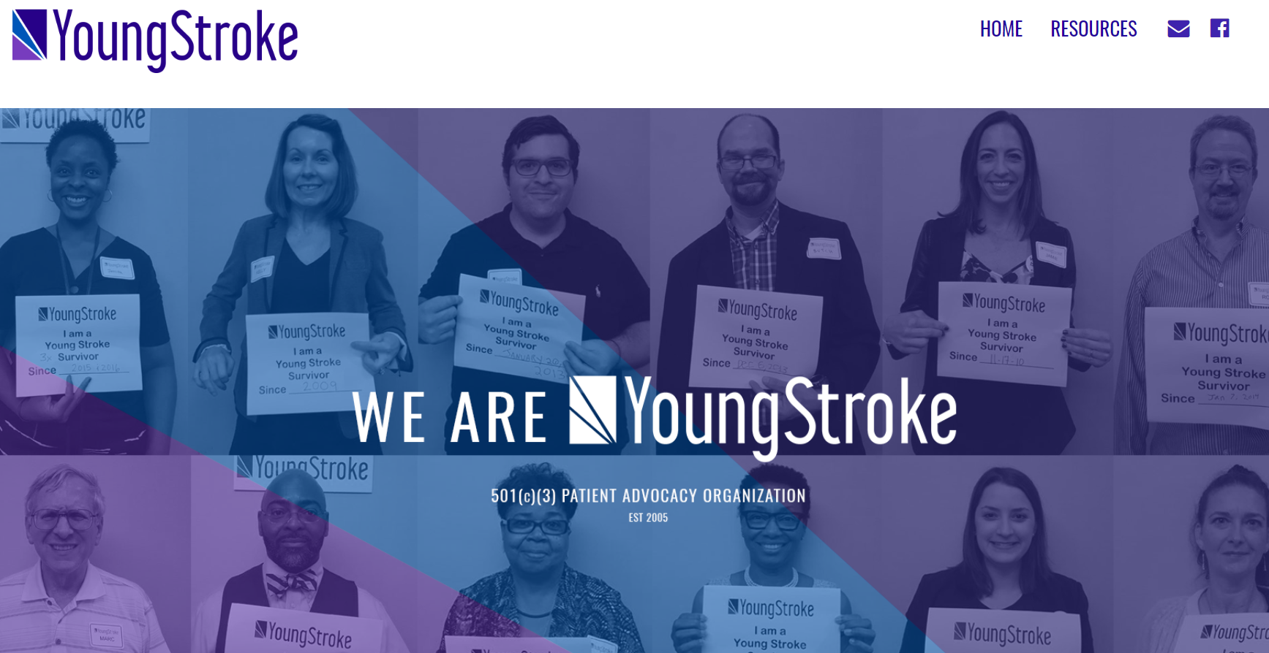
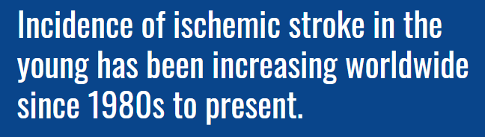

Slide 2
Stroke in the Young – An Epidemic
George et al. (2017) reviewed U.S. hospitalization data from the National Inpatient Sample
Review of two large data sets (combined n=784,154 hospitalizations) showed significant increase in acute ischemic stroke (AIS) hospitalization rates for men and women
Rates have nearly doubled for men aged 18-34 and 35-44 since 1995-1996. Rates for older adults 55-64 have not changed from 2003-2004
Trends are consistent with other studies
Notes:
Females affected predominantly in the under 30 age group (Helsinki Study).
Posterior Circulation – cerebellum

Slide 3
The shared mechanism between mental illness, stroke, and dementia
is oxidative stress
“The brain is especially susceptible to ROS – it is a major metabolizer of O2, yet has relatively feeble protective antioxidant mechanisms”
Popa-Wagner, A., Mitran, S., Sivanesan, S., Chang, E., & Buga, A.-M. (2013). ROS and brain diseases: the good, the bad, and the ugly. Oxidative Medicine and Cellular Longevity, 2013.
Notes:
Oxidative Stress in Brain Disease
For any condition you see in the office you can research the mechanisms and see whether there is overlap – this ist he way to communicate this material to colleagues

Slide 4
Oxidative Stress and Cardiovascular Disease
In conditions associated with increased oxidative stress and inflammation (ischemic heart disease, cardiomyopathy, hypertension) NO and superoxide (O2•−) react to form peroxynitrite (ONOO−) which induces cell damage via oxidation and nitration:
lipid peroxidation
inactivation of enzymes/proteins
activation of stress signaling
Pacher, P., Beckman, J. S., & Liaudet, L. (2007). Nitric oxide and peroxynitrite in health and disease. Physiological Reviews, 87(1), 315-424.

Slide 5
Oxidative Stress and Heart Failure
NTP Cell Phone Study included cardiac findings
  1) Cardiac Tumors (schwannomas)
  2) RV Cardiomyopathy
  HF and EMFs - overlapping mechanisms
  1) Oxidative Stress
  2) Mitochondrial Dysfunction
Pacher, P., Beckman, J. S., & Liaudet, L. (2007). Nitric oxide and peroxynitrite in health and disease. Physiological Reviews, 87(1), 315-424.

Slide 6
EMFs – An Emerging Risk Factor for Cardiovascular Disease
Increasing proportion of ST elevation MI patients lack traditional cardiac risk factors (Vernon ST, Eur J Prev Cardiol 2017)
RF is an environmental pollutant with cytotoxic effects
RF generates oxidative stress, which is implicated in CVD
RF may contribute to CVD via oxidative cellular damage
Bandara, P., & Weller, S. (2017). Cardiovascular disease: Time to identify emerging environmental risk factors. In: SAGE Publications Sage UK: London, England.
Notes:
Hyperlipidemia, htn, DM, smoking
Human exposure to RF and other emfs has increased exponentially
Altering signal transduction pathways

Slide 7
RFR Causes Oxidative Stress
Review of 100 available peer reviewed studies of oxidative effects of low intensity RFR
93/100 confirmed that RFR induces oxidative effects in biological systems
Conclusion: Low intensity RFR is an oxidative agent for living cells with a high pathogenic potential
Yakymenko, I., Tsybulin, O., Sidorik, E., Henshel, D., Kyrylenko, O., & Kyrylenko, S. (2016). Oxidative mechanisms of biological activity of low-intensity radiofrequency radiation. Electromagnetic Biology and Medicine, 35(2), 186-202.
Notes:
If you only want to learn one EMF bioeffect, this is the one
Everything bad

Slide 8
Dhalla, N. S., Temsah, R. M., & Netticadan, T. (2000). Role of oxidative stress in cardiovascular diseases. Journal of Hypertension, 18(6), 655-673.
Notes:
Various sources of ROS in health and disease

